Slide 1
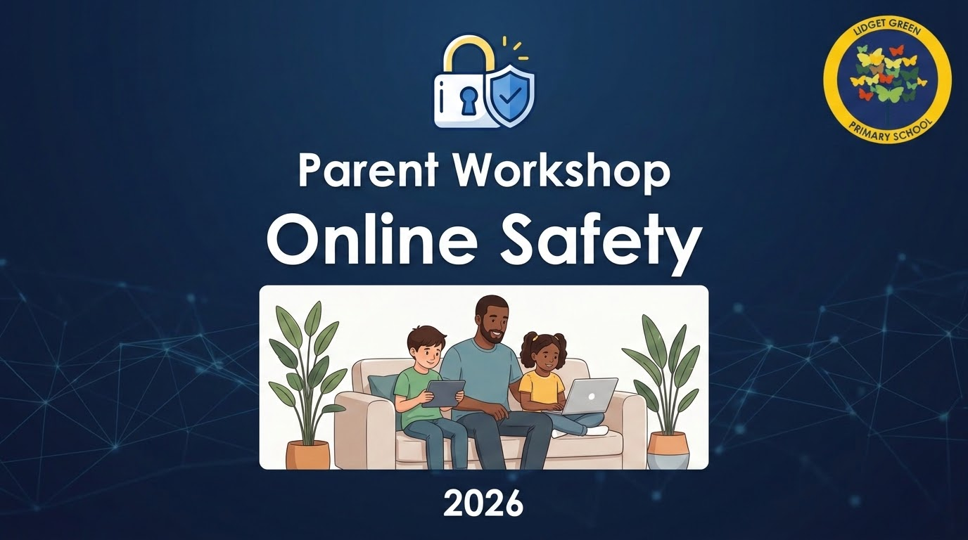
Notes:
Today is about supporting parents with practical advice around online safety.
Children’s online lives are now part of everyday life. Devices are used for learning, socialising, gaming and entertainment.
Our aim today is not to create fear around technology. Instead, we want to help families feel more confident, informed and supported.

Slide 2

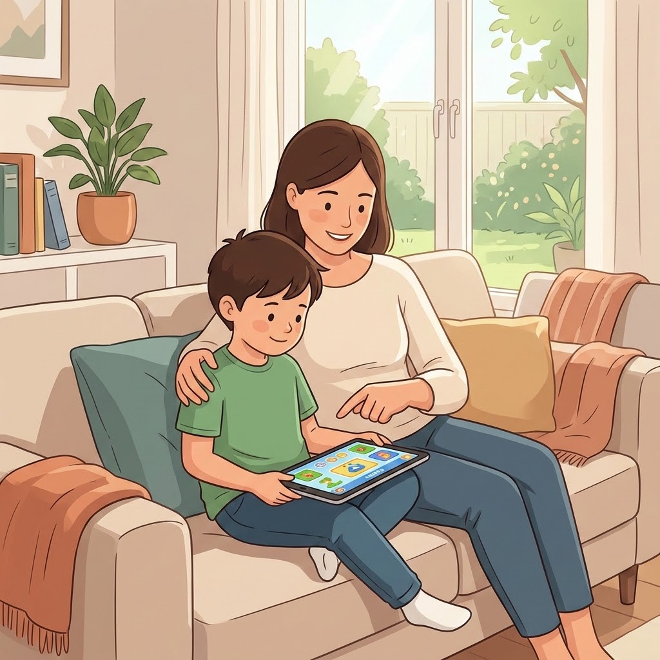
Aims of the Session
visibilityHelp parents understand risks
trending_upBuild confidence
buildProvide practical strategies
Discussion Points:
What apps do your children use?
Do you know the age restrictions for these apps?
Notes:
By the end of the session, I hope parents will:
Understand the main online risks children may face
Feel more confident having conversations about online safety
Leave with practical strategies to use at home
Before we begin, think about this:
What apps or games does your child currently use?
And do you know the age restrictions for those platforms?

Slide 3
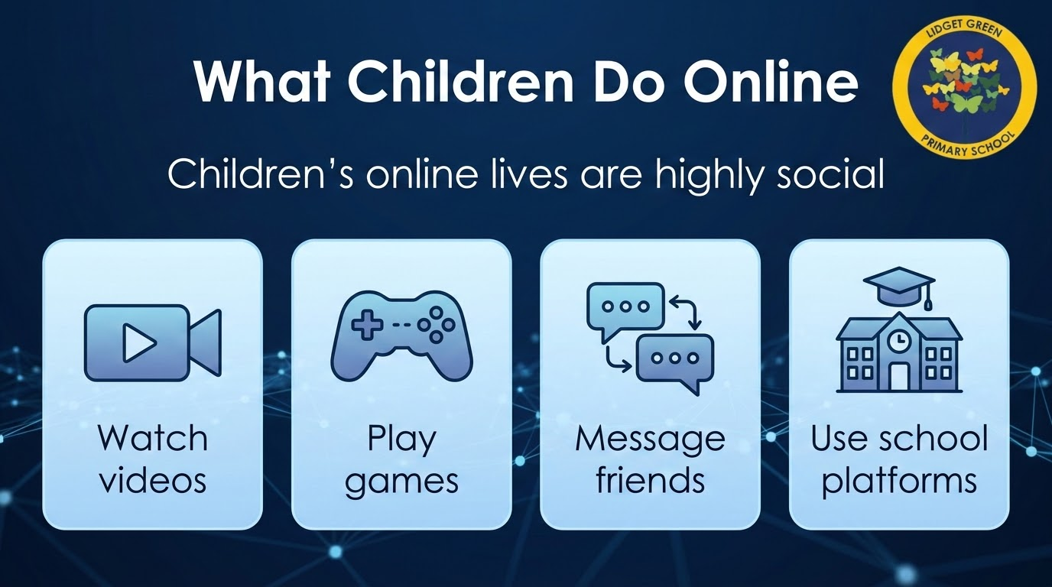
Notes:
Many risks online come through interaction with others rather than simply looking at websites.
Children use devices to:
Watch videos
Play games
Message friends
Complete school learning
Technology itself is not the problem.
The focus should be on helping children use technology safely, confidently and responsibly.

Slide 4
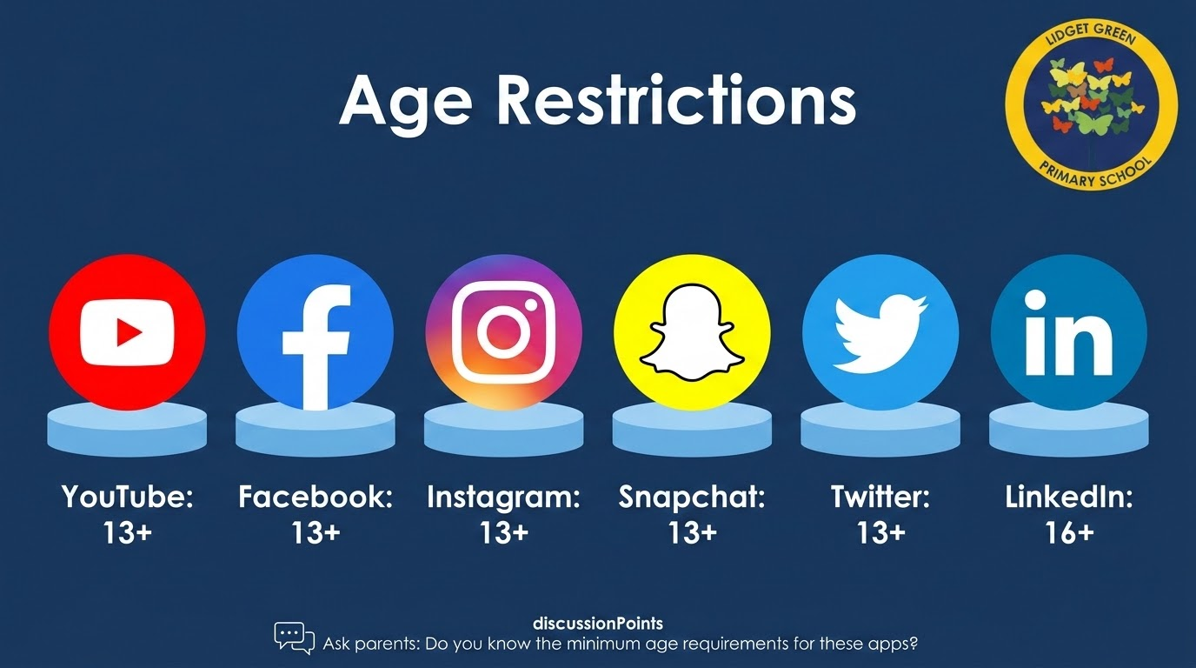
Notes:
Most apps require users to be at least 13 years old. Many parents are surprised to learn that most social media apps have a minimum age of 13
This links to laws around collecting children’s personal information online.
However, we know many younger children access these apps.
The important thing is that parents understand:
What their child is accessing
Who they are communicating with
Whether safety settings are in place
One of the strongest protective factors is simply staying involved.

Slide 5
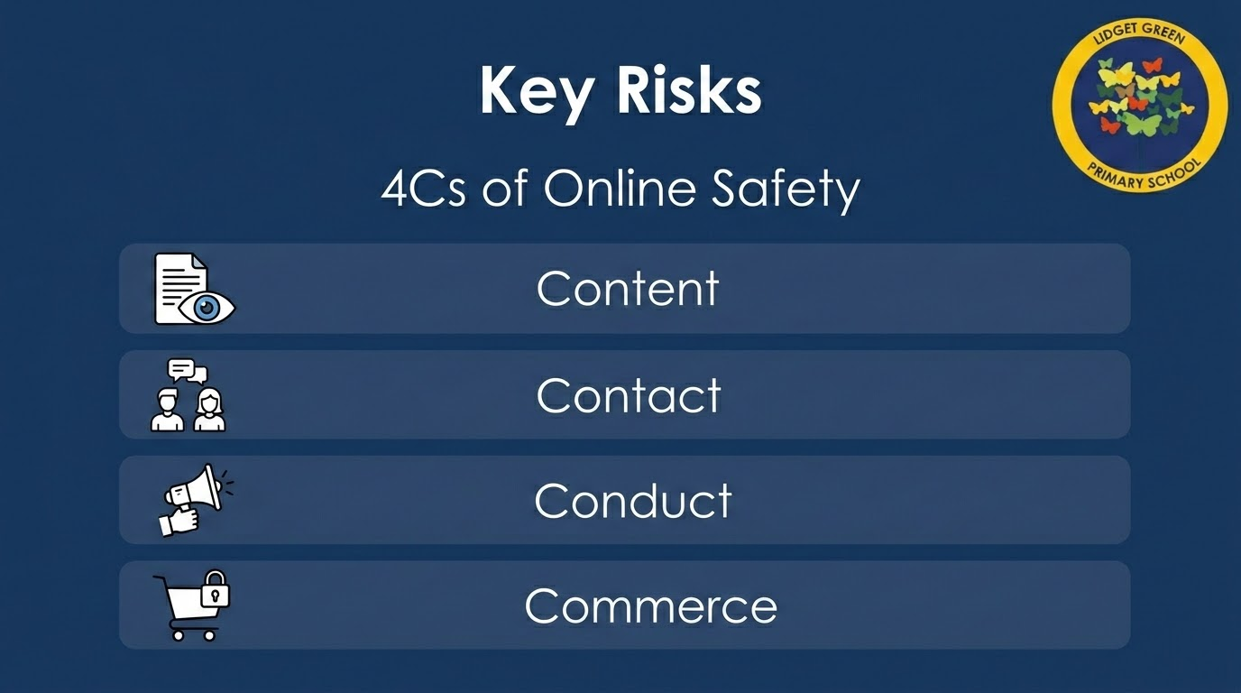
Notes:
Online safety is grouped into four main areas called the 4Cs
Content - things children see online:
Violent material
Misinformation
Inappropriate videos
Harmful trends
Contact - interactions with people online:
Grooming
Strangers contacting children
Cyberbullying
Conduct - how children behave online
Sharing images
comments/messages
Digital footprint
Commerce - these are financial risks
In- game spending
Loot boxes
Scams
Phishing
Understanding these areas helps parents recognise risks more clearly.

Slide 6
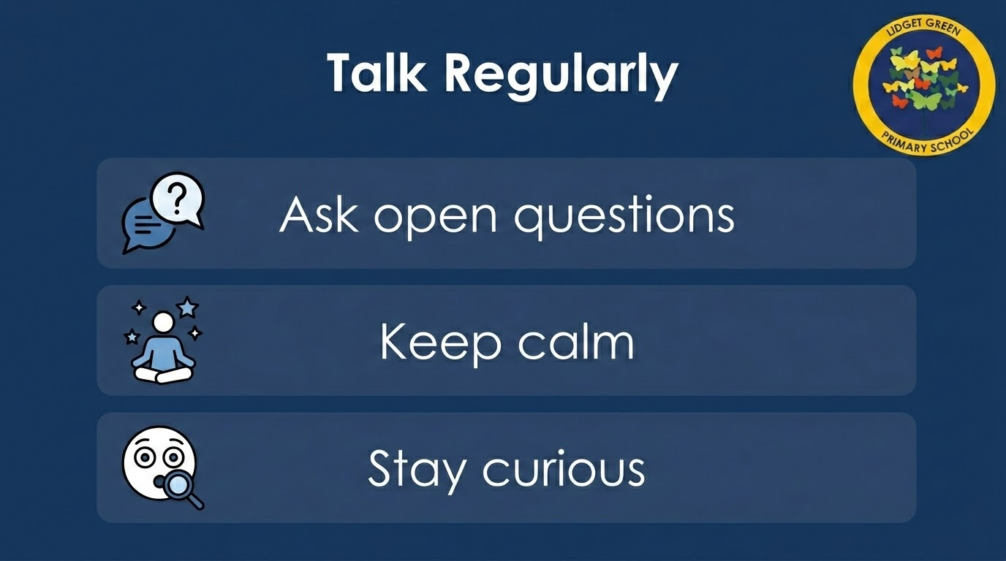
Notes:
One of the biggest messages I need to share today is this: online safety should be an ongoing conversation
Try:
Asking open ended questions
Staying calm
Avoiding immediate punishment
Showing curiosity rather than judgement
Useful questions you could ask:
What games are popular at the moment?
Who do you talk to online?
Have you ever seen anything that made you uncomfortable?
Children are far more likely to tell adults about problems if they believe that they will be listened to calmly.

Slide 7
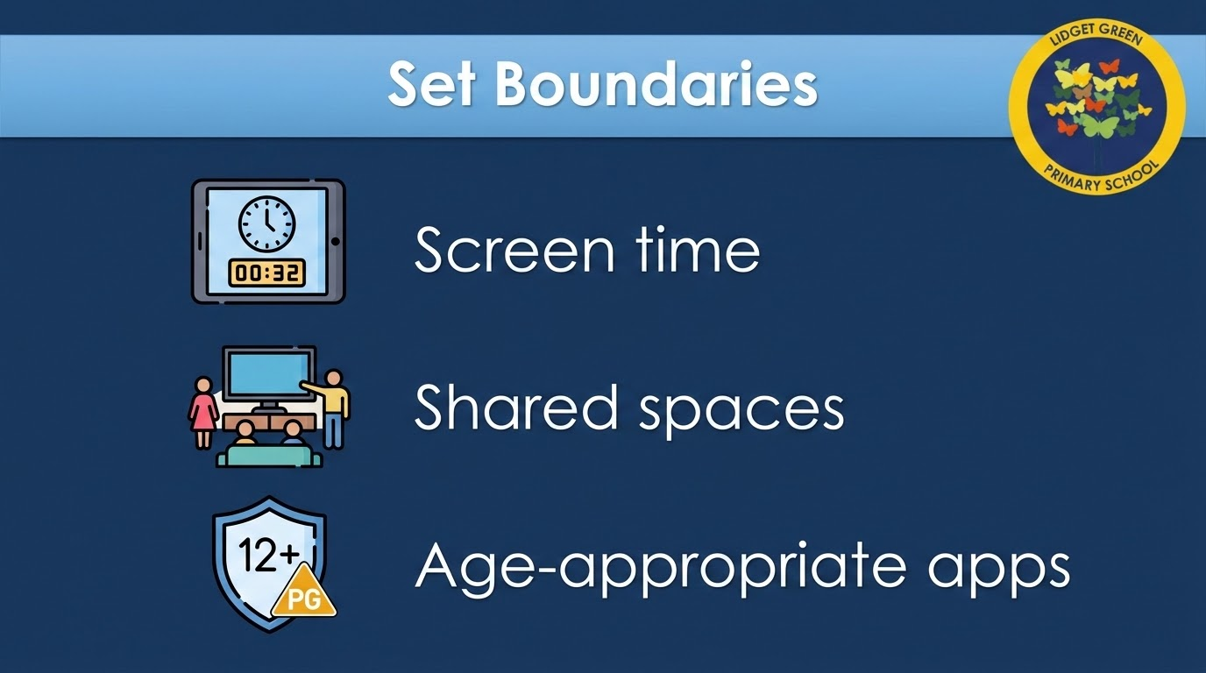
Notes:
Children benefit from clear routines and expectations online.
Practical boundaries may include:
Devices staying downstairs overnight
Screen free mealtimes
Shared family spaces for devices
Checking apps before download
Time limits
Parental controls are helpful - but they work best alongside conversations and supervision.

Slide 8
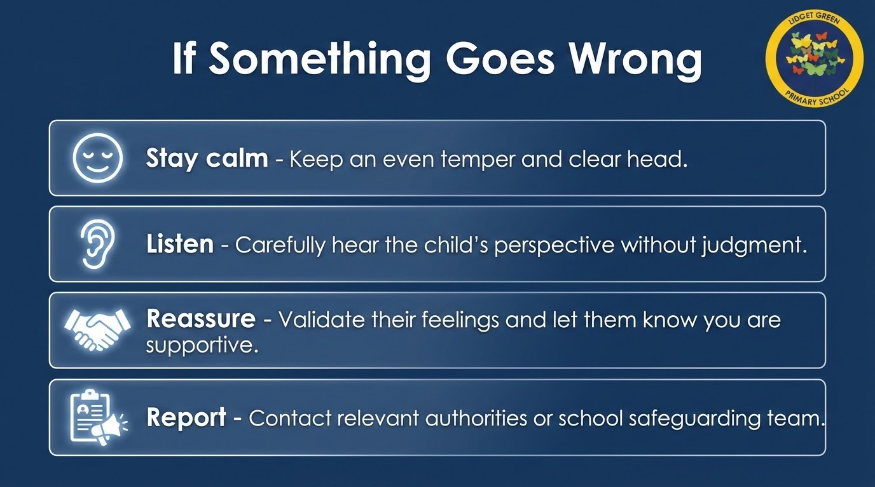
Notes:
If a child comes to you with a problem online, your first reaction really matters.
Try to:
Stay calm
Listen carefully
Reassure them
Avoid blame
Report concerns if needed
Children fear having devices removed.
We want children to keep speaking up when something worries them.

Slide 9
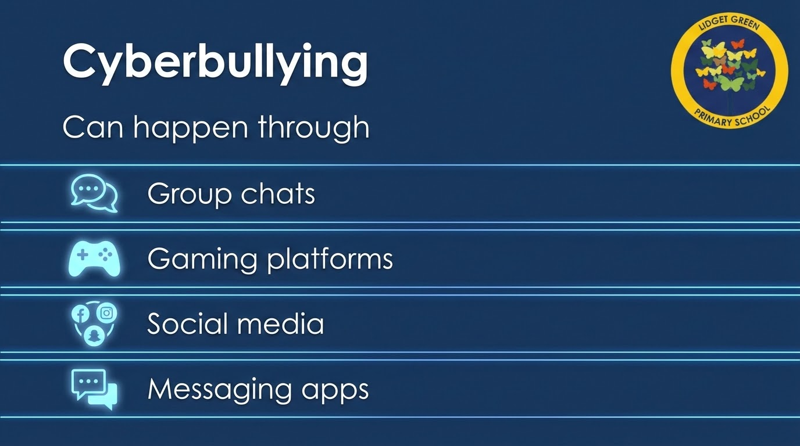

Slide 10
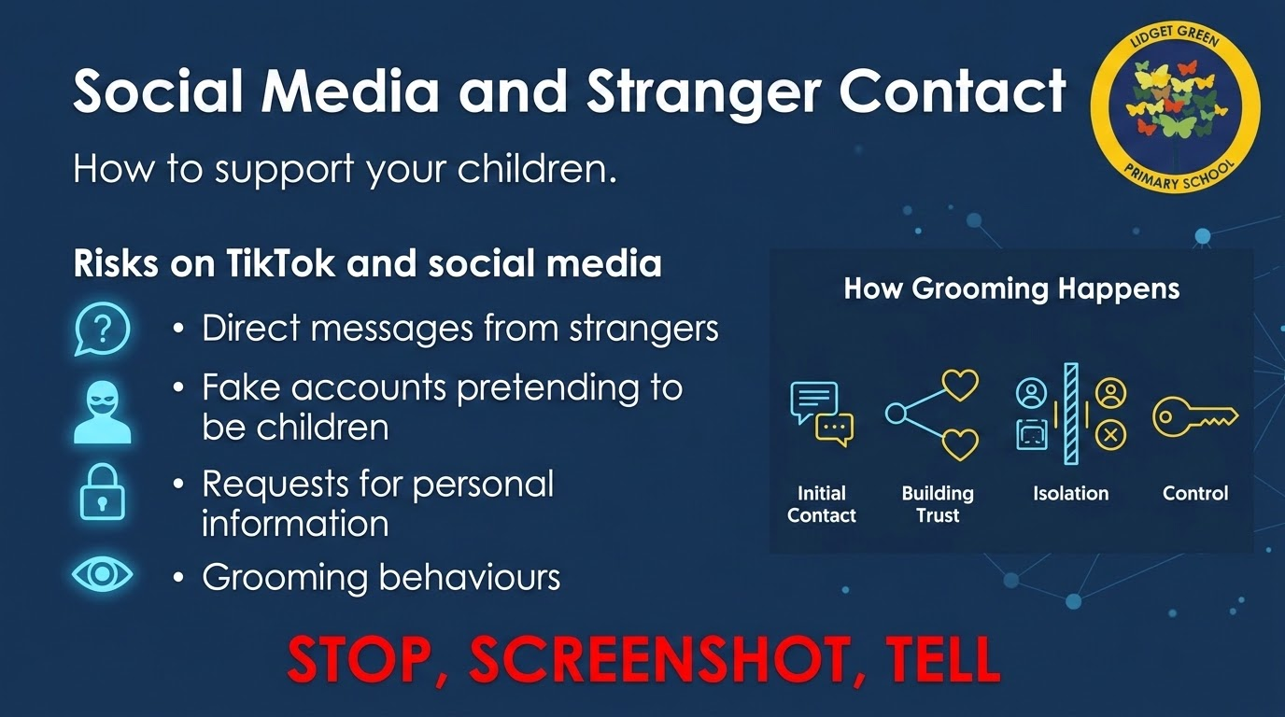
Notes:
Many online contacts begin in a friendly way.
Children may be contacted through
TikTok
Snapchat
Gaming platforms
Group Chats
Risks include:
Fake accounts pretending to be children
Requests for personal information
Grooming behaviours
Parents can help by:
Setting accounts to private
Turning off direct messaging where possible
Using family pairing features
Keeping devices in shared spaces
Teach children three simple steps - Stop, Screenshot, Tell
Children should know they will never be in trouble for asking for help.

Slide 11
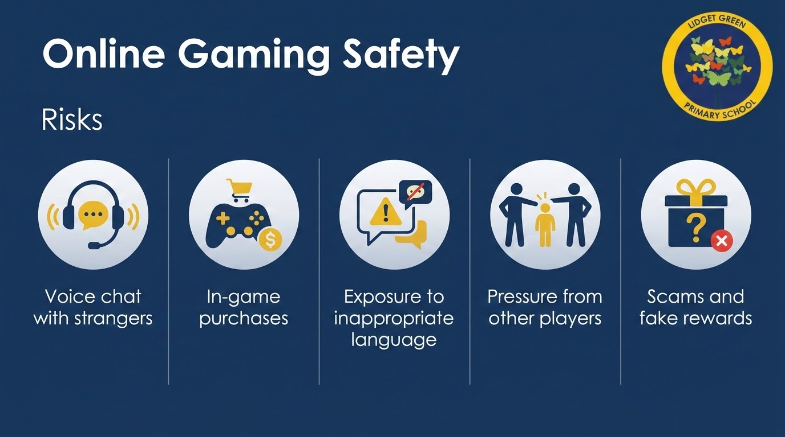
Notes:
Online gaming is hugely popular and often very social.
Games can involve:
Voice chat with strangers
Pressure from other players
In-game spending
Exposure to inappropriate language.
Practical steps you can take:
Turn off open chat
Use age ratings
Keep consoles in shared spaces
Use parental controls
Check friends lists regularly
Online gaming platforms worth mentioning here include - Roblox, Fortnite and Minecraft as these are commonly used by primary aged children.
Gaming can be positive and social - but children still need guidance and boundaries.

Slide 12
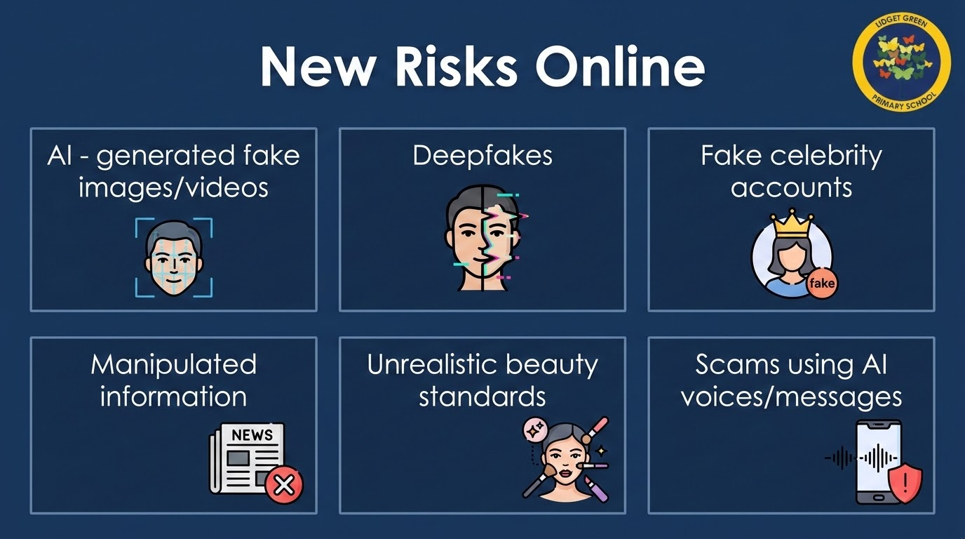
Notes:
Children increasingly encounter AI-generated content online.
This can include:
Fake images
Deep Fake videos
Unrealistics influencers
Scams using AI messages or voices
Encourage children to ask:
Is this real?
Can this be trusted?
Why was this shared?
Digital literacy is now a vital safeguarding skill.

Slide 13
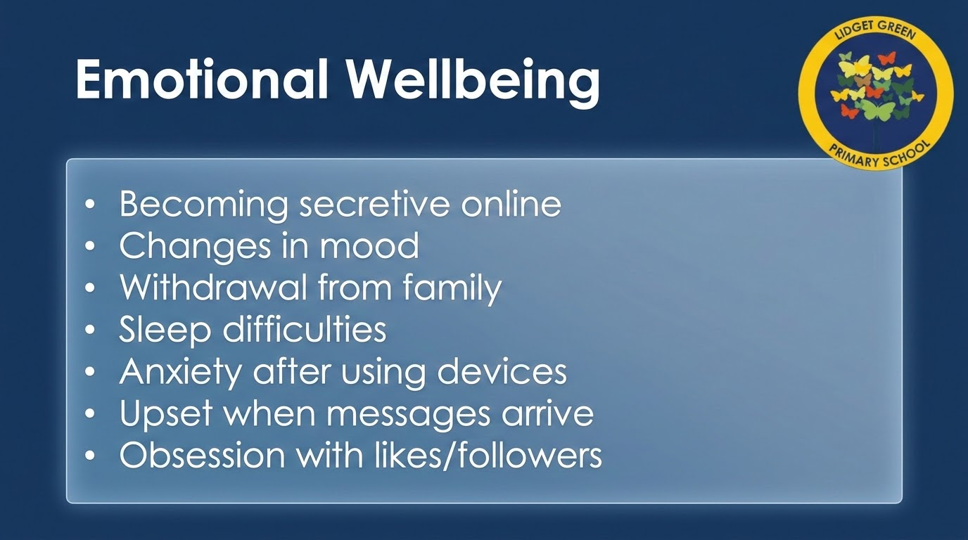
Notes:
Online experiences can strongly affect children’s wellbeing
Watch out for signs such as:
Changes in mood
Sleep difficulties
Anxiety after using devices
Obsessive checking
Withdrawn from family
Again, the key is communication. We are not aiming for perfection. We are aiming for openness, support and safety.
It is not possible to monitor every second - it is to maintain trust, communication and safety.

Slide 14
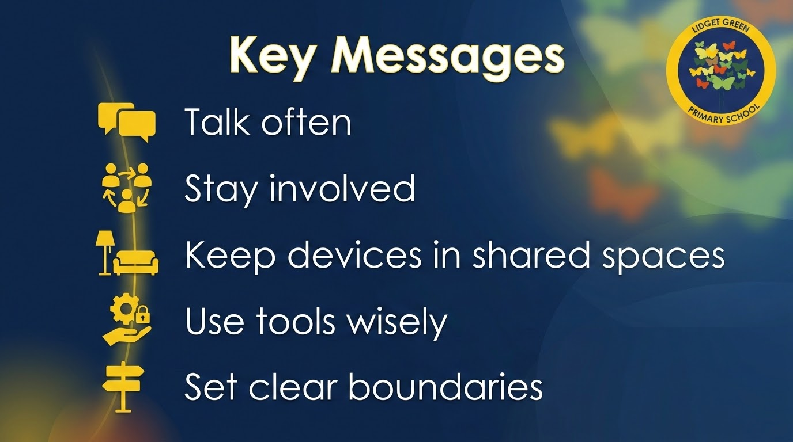
Notes:
Online safety can sometimes feel overwhelming for parents because technology changes so quickly. But children are safest when trusted adults stay involved and keep conversations going.
Even small changes at home can make a significant difference.

Slide 15
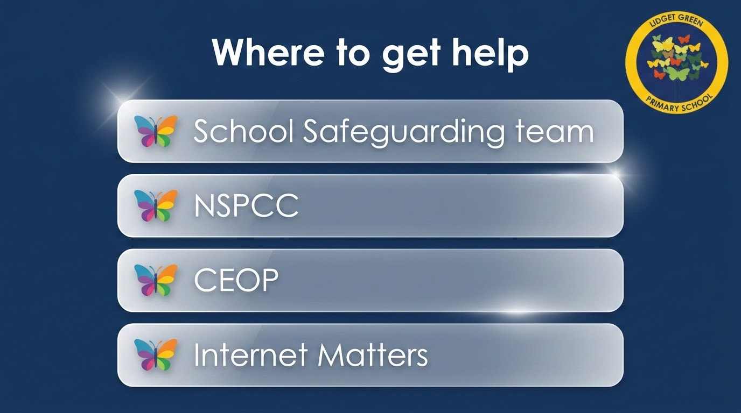
Notes:
If you ever feel worried or unsure, support is available.
Useful organisations include:
NSPCC
CEOP - (Child Exploitation and Online Protection)
Childline
Internet Matters
And please remember: School safeguarding staff are always available to help and support families.

Slide 16
