Slide 1
Special Education Needs & Disability & Inclusion in our school Sept 2018/19

Slide 2
What does the Special Education Needs Register look like in our school?
Class | Number of children in year group | Number of children with SEN support | Statement /EHCP
Nursery | 62 | 6 | 1
Reception | 82 | 11 | 4
Year 1 | 73 | 15 | 2
Year 2 | 90 | 22 | 2
Year 3 | 73 | 15 | 0
Year 4 | 70 | 8 | 0
Year 5 | 76 | 13 | 1
Year 6 | 75 | 23 | 2
Total | 600 | 115 | 12

Slide 3
What are the children’s Special Education Needs?
Cognition & Learning
Communication & Interaction
Physical/Sensory Difficulties includes Medical needs
Social Emotional Mental Health
Multiple/complex needs

Slide 4
SEND by Need

Slide 5
How are children with Special Education Needs Identified?
Parental concerns
School
External Agencies- Medical- early

Slide 6
Inclusion Staffing Overview
Position | Name
Inclusion Manager/SENCO | Afshan Hassan
Inclusion & Safeguarding Officer | Angela Oldfield
Learning Mentor | Sherrie Lake
Site Manager/Learning Mentor | Michael Hirst
Attendance Officer/Learning Mentor | Ikhlaq Khan
Parental Involvement Worker | Kamaljit Kaur
TLAs- SEN TLAs – New to English | Attia Asghar, Sara Suleman, Shahnaz Ahmad, Zarnain Rizvi, Iram Iqbal, Maria Ali, Penny Wilkinson, Sophia Khatoon, Parveen Kauser, Natalie Henry, Zahra Masooma, Malgorzata Banasiak, Nabila Hussain

Slide 7
What interventions are taking place?
Refuelling- Magic Bullet/Rocket/Refuelling Book across Year Groups- TLAs
Beanstalk Readers & other volunteers
Learning Mentors- 1:1/ groups (Referrals reminder)
Forest schools

Slide 8
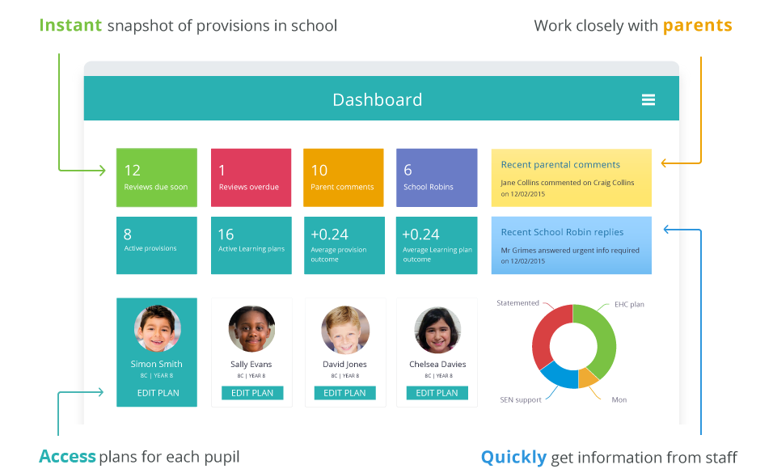
‘Provision map’ software to write Individual Learning Plans

Slide 9
What services are working with SEN children in our school?
Educational Psychologist
Hearing Impaired Team
Learning Support Services
Speech & Language
SEBD Team (not currently)
CAMHS

Slide 10
Where is the money spent?
Staffing
Training
Resources including ICT

Slide 11
Future for SEN in our school
Audits of SEN resources/staff needs/staff strengths
Early identification- Little Bears/Big bears
TLA performance management
Further training for Teachers and TLAs on SEN
TLAs to work effectively and share good practice- classroom & interventions
Regular Pupil Progress Meetings (on calendar)
Inclusion Team to meet once every half term to discuss progress
Effective use of Provision Map software
Replacement of P Levels -?

